Slide 1
Question 1:
You are analyzing titanium alloy implants meant for biomedical use.
The parts were cleaned and sterilized, but several batches fail adhesion tests with a ceramic coating.
Your supervisor suspects surface contamination.
You perform X-ray Photoelectron Spectroscopy (XPS) and observe unexpected peaks near 284 eV (C 1s) and a weak O 1s shoulder.
1) What is the physical principle behind XPS? How does the photoelectric effect let us identify elements?
2) What do the terms binding energy, work function, and Fermi level represent conceptually in XPS?
3) Why does XPS detect only the top 5–10 nm of the surface?
4) What could the peaks at 284 eV and the O 1s shoulder indicate?
5) What limitations or artifacts could complicate interpretation (e.g., charging, peak fitting)?
6) How would you verify if the contamination is truly carbonaceous?
Question 2:
You receive a fractured piece of stainless-steel tubing used in chemical processing.
Under the SEM, you notice differences in brightness between grains and along crack paths.
You also collect EBSD and EDX data.
1) What is the difference between secondary electrons (SE) and backscattered electrons (BSE) in SEM, and what information does each provide?
2) Why do some grains appear brighter in BSE mode?
3) How does EBSD reveal crystallographic orientation and grain boundaries?
4) How does EDX identify the alloy’s chemical composition?
5) What combination of signals would help determine whether the crack propagated along grain boundaries or through grains?
6) What limitations should you consider when interpreting these datasets?
Question 3:
A research team analyzes thin oxide films on semiconductor wafers using three techniques:
  XPS → detects elements and chemical states in top 5 nm
  SIMS → provides depth profiles of trace impurities
  EDX → gives bulk composition from SEM cross-sections
They obtain different results for oxygen concentration.
1) Why might XPS, SIMS, and EDX give different oxygen contents on the same sample?
2) What is the sampling depth and information type for each technique?
3) Which technique gives the most surface-specific data? Which provides depth distribution? Which gives bulk composition?
4) What are limitations of each (charging, matrix effects, quantification)?
5) How could these techniques be combined to get a complete picture of the sample?

Slide 2
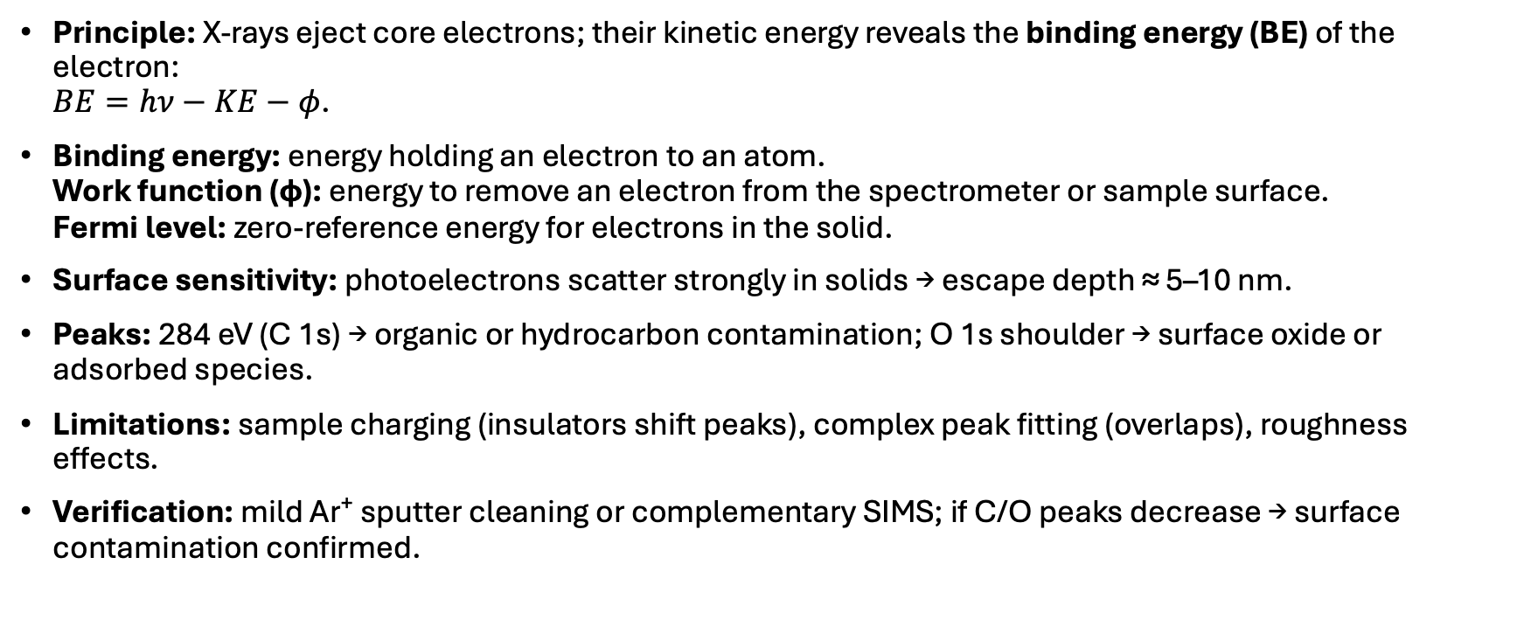
Question 1
Principle: X-rays eject core electrons; their kinetic energy reveals the binding energy (BE) of the electron:
$BE=hν−KE−φ$.
Binding energy: energy holding an electron to an atom.
Work function (φ): energy to remove an electron from the spectrometer or sample surface.
Fermi level: zero-reference energy for electrons in the solid.
Surface sensitivity: photoelectrons scatter strongly in solids → escape depth ≈ 5–10 nm.
Peaks: 284 eV (C 1s) → organic or hydrocarbon contamination; O 1s shoulder → surface oxide or adsorbed species.
Limitations: sample charging (insulators shift peaks), complex peak fitting (overlaps), roughness effects.
Verification: mild Ar⁺ sputter cleaning or complementary SIMS; if C/O peaks decrease → surface contamination confirmed.

Slide 3
Question 2
SE: low-energy electrons from near surface → topography.
BSE: high-energy electrons elastically scattered → contrast from atomic number (Z-contrast).
Brighter grains: higher mean atomic number or orientation favoring electron backscatter.
EBSD: diffracted BSEs form Kikuchi patterns → map of crystal orientation, grain boundaries, misorientations.
EDX: X-rays emitted from atomic shell transitions → element identification and approximate composition.
Crack path: EBSD shows boundary misorientations; EDX reveals segregation of elements at boundaries → intergranular vs transgranular fracture.
Limitations: spatial resolution limited by interaction volume (~1 µm), need for polished surface, and orientation-dependent contrast.

Slide 4
Question 3
Different results: each probes different depths and sensitivities (surface vs bulk vs trace).
Sampling depths:
  XPS ≈ 5–10 nm (surface chemistry)
  SIMS ≈ up to µm (depth profiles, very sensitive)
  EDX ≈ 1 µm + (bulk average).
Most surface-specific: XPS; depth profiling: SIMS; bulk: EDX.
Limitations:
  XPS → charging, quantification uncertainty for light elements.
  SIMS → matrix effects, destructive, difficult quantification.
  EDX → poor surface sensitivity, overlapping peaks.
Combination:
  Use XPS for surface chemistry,
  SIMS for impurity depth profile,
  EDX for bulk stoichiometry → complementary, multi-scale understanding.

